Slide 1


HPRC and MathWorks Present: Controls Design Onramp

Slide 2
Today:
6:15 pm – 6.30 pm: Set-up
Intro to Control Systems
Create MathWorks account
Log in to Machine Learning Onramp
6.30 pm – 8.00 pm: Control Design Onramp (on your own)

Slide 3
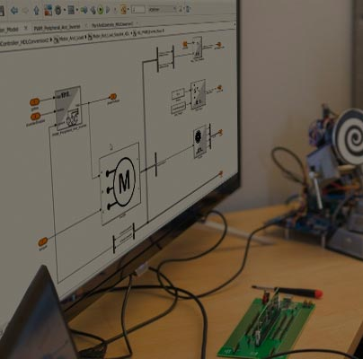
What is control system
A control system is a device that regulates the response of a system
Control systems are typical computer algorithms
Ex. AC regulating temperature, cruise control regulating speed

Slide 4
Why are controllers needed?
External forces affect systems behavior
Manually accounting for errors can cause overshooting
Need controller that accounts for the error in the position
Too much power
Friction
Air resistance
1 meter
Too short
Just right
Too far
Notes:
Calculating position from only speed is extremely susceptible to disturbances or inconsistencies in a system.
This also assumes the motors move at the speed they are commanded
If the motors do not, there is an error, which should be reduced with feedback from encoders

Slide 5
Basic Control System Model
Input
Error
Controller
Plant
Output
+
-
Feedback
Sensors

Slide 6
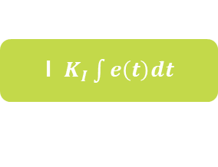



PID Controller
Most common controller that uses three gain terms:
P: Proportional Gain – applied to the difference between the desired and measured value (error)
I: Integral Gain – applied to the continuous sum of errors
D: Derivative Gain – applied to the change in error over time
P $K_{p}e(t)$
$$e\left(t\right)$$
+
I $K_{I}\int{e\left(t\right)dt}$
+
error
+
D $K_{I}\frac{de(t)}{dt}$
Notes:
For our purpose: a PID controller is a way of representing past, present and future error of a controller.
PID controllers are a more precise way of having the DC motors move the rover from point a to point b.
Each term controls a different flaw that might occur: proportional error moves the rover closer to the target. Derivative prevents the rover from overshooting the target, and integral makes sure the rover does not stop near the target, and reaches it fully.
There is a gain associated with each term that amplifies or diminishes the effect of each term depending on the response you want.

Slide 7
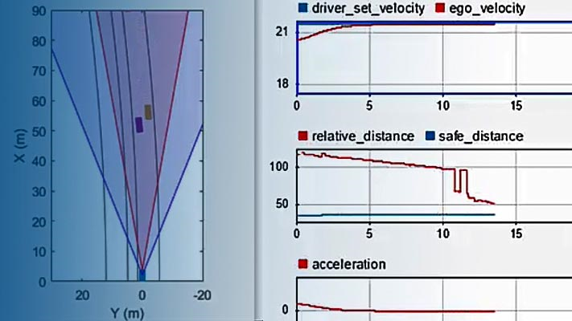
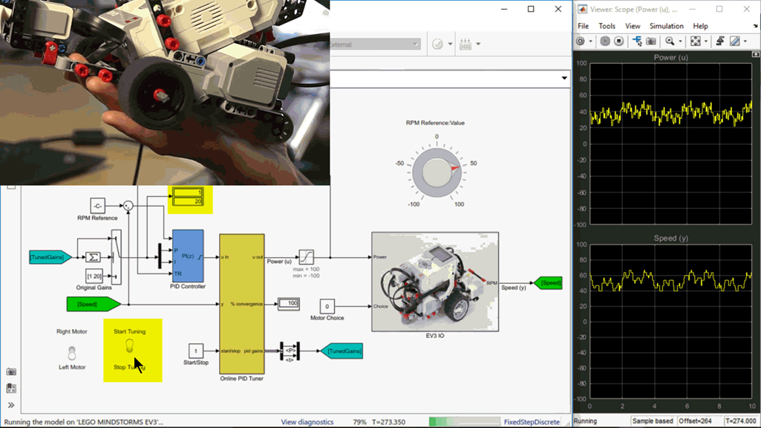
Control Systems with Simulink
Automatically tune arbitrary SISO and MIMO control architectures
PID autotuning can be deployed to embedded software for automatically computing PID gains in real time.
Interactively compute operating points from state, input, and output specifications
Compute simulation-based frequency responses without modifying your model.

Slide 8
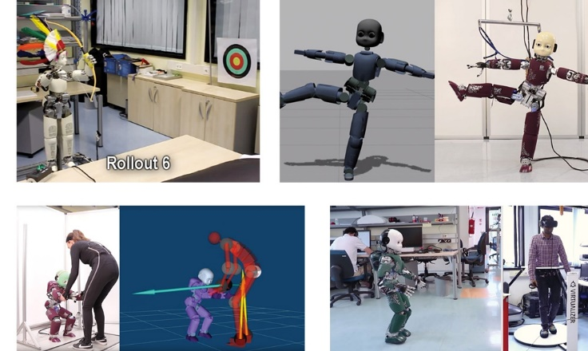
Italian Institute of Technology Develops Advanced Control Software for the iCub Humanoid Robot
Challenge
Design and implement control algorithms for a humanoid robot with 53 degrees of freedom
Solution
Use Model-Based Design to develop controllers, verify them via cosimulation, and test them on the robot
Results
Telexistence and agent-robot collaboration control systems developed
Independent robot operation implemented with generated code
Control design reused on multiple humanoid robot platforms
Clockwise from top left: iCub shooting arrows, striking a yoga pose, walking while controlled via teleoperation, and working with a human to stand up.
“Our team has created a development workflow based on Simulink and Simulink Coder that makes it possible for even inexperienced team members to rapidly implement new control features, validate them through simulation, and run them on an iCub robot without writing any low-level code.” - Daniele Pucci, Italian Institute of Technology (IIT)
Link to technical article
Notes:
Industries: Academia
Application Areas: Control Systems, Embedded Systems, Robotics
Capabilities: Algorithm Development, System Design and Simulation
Products Used: MATLAB, Simulink, Embedded Coder, Simulink Coder
Country: Italy
Published in 2019
Figures/images available in online version
Product names are current at time of technical article publication.
Developing Advanced Control Software for the iCub Humanoid Robot
By Daniele Pucci, Diego Ferigo, and Silvio Traversaro, Istituto Italiano di Tecnologia (IIT)
The iCub project was launched in 2004 as part of the RobotCub European Project, whose main aim was to study embodied cognition—the theory that an organism develops cognitive skills as it interacts with its environment (see sidebar). The main outcome of the iCub project is a one-meter-tall, 53-degrees-of-freedom humanoid currently being developed at the Italian Institute of Technology (IIT). Over the years, the iCub robot has been used as a research platform for diverse fields of applied robotics, including balancing, teleoperated walking, and robot-human collaboration (Figure 1).
iCub is equipped with more than 50 motors, as well as force-torque sensors, inertial measurement units, and dozens of encoders and accelerometers. Developing control algorithms for a robot this complex is a difficult challenge. Our team at IIT—the Dynamic Interaction Control team—has created a development workflow based on Simulink® and Simulink Coder™ that makes it possible for even inexperienced team members to rapidly implement new control features, validate them through simulation, and run them on an iCub robot without writing any low-level code.
iCub Research at IIT
The IIT iCub project includes several lines of research. The Dynamic Interaction Control team focuses on three areas: telexistence, agent-robot collaboration (with the agent being either a human or another humanoid robot), and aerial humanoid robotics.
Telexistence enables a human to exist virtually in another location via a robotic avatar. In our telexistence experiments, the iCub walks and manipulates objects in the real world while the human walks and manipulates objects in a virtual environment. When the human takes a step, we process the human motion and a reference signal is sent to the iCub, causing it to take a step. Similarly, when the human closes a hand, a signal is sent to cause the iCub’s hand to close.
Our research into agent-robot collaboration centers on ways that humans and robots can work together. In one of our experiments, a human helps the iCub to stand from a sitting position. The human wears a specially designed suit that provide real-time kinematics and dynamics data, enabling us to track and model the human’s movements and muscular stresses alongside the robot’s movements in Simulink. We recently extended the human-robot collaboration experiment with a robot-robot collaboration version in which one iCub helps a second iCub to stand (Figure 2).
Aerial humanoid robotics is one of our most active research areas. We are working on a version of iCub that will be equipped with jetpacks. It will be able to fly to a specified location, land, and begin walking and interacting with the environment (Figure 3). A robot with these capabilities would be useful in high-risk disaster and search-and-rescue scenarios, such as earthquakes, floods, or wildfires. In these situations, the value of having robots able to fly from one building to another looking for survivors, open doors, close gas valves, and enter buildings is incalculable.
Prototyping iCub Controllers
We prototype our control software using Simulink and the open-source Whole Body Toolbox, developed at IIT. Whole Body Toolbox is based on the BlockFactory dataflow framework, which we created to provide C++ interfaces for dataflow programming. We begin by modeling the controller in Simulink, incorporating sensors, actuators, and commonly used robotic algorithms. The Whole Body Toolbox then creates interfaces to either the real or the simulated iCub (Figure 4).
We use the Whole Body Toolbox most frequently on projects that involve dynamic balancing: The robot controller regulates the contact forces between the robot and the environment, enabling the robot to maintain its balance even if pushed or otherwise perturbed by a human. As a secondary task, the robot tries to maintain a posture chosen by the operator, filtering out any posture that alters its balance and stability.
We cosimulate the control model in Simulink with a model of iCub in the Gazebo robotics simulator (Figure 5). Cosimulation enables us to fix defects before testing on the actual robot, minimizing the risk of damaging the robot or endangering a human.
For example, with our cosimulation setup we can determine whether a given set of gains creates unstable behavior in the robot in the event of unplanned fast movements.
iCub streams measurements coming from sensors at 100 Hz. These measurements are published over the network by our robotic middleware YARP. We typically sync the update rate of our controllers to the rate of the input measurements.
Once we have validated the controller via simulations, we test it on a real iCub in the lab. In our test setup, Simulink runs on a PC with a standard x86 processor and communicates with the iCub via YARP middleware and TCP/UDP. The controller running in Simulink sends torque commands to the robot, which is able to follow a trajectory while maintaining its balance. A real-time synchronizer block, developed for the Whole Body Toolbox, synchronizes the robot moving in the real world with the control model.
Deploying the Controller
Our over-the-network configuration is convenient for rapid design iterations, but it leaves iCub reliant on the TCP/UDP communication link. To break this reliance and enable iCub to operate more independently, we deploy our controller to an x86 processor inside the robot’s head, eliminating the need for network communication, with the associated latency and risk of communication errors.
We generate C++ code from our control models with Simulink Coder, compile it, and validate it using the same over-the-network configuration that we used earlier when running the controller in Simulink. Then, we run the code on the x86 processor mounted inside iCub’s head, enabling iCub to operate independently as a single unit rather than on a separate control PC.
Portable Control Design
Today, about 40 iCub robots are in use by research groups around the world. Although the hardware designs vary, every version can use the same controller design. This portability is made possible by a configuration block within our Simulink control model that loads a Unified Robot Description Format (URDF) file describing the kinematics and dynamics of each robot. Using this configuration file, we can run the same controller on IIT’s 120-kilogram, 1.85-meter-tall simulated Walkman as on a 33-kilogram, 1-meter-tall iCub.
Looking Ahead
We are confident that our research will result in many real-world applications. For example, in the future, telexistence could be used to help the physically disabled perform tasks requiring strength or dexterity. In these cases, a robotic avatar would move and act in the physical world, remotely controlled by the disabled human.
Our research on human-robot collaboration is fundamental to creating robots to help humans at home and in the workplace—for example, assisting the elderly with activities of daily living and helping factory workers perform tasks involving muscular skeletal stress. Finally, the new branch of robotics that we are pioneering, aerial humanoid robotics, has a multitude of applications. Jet-powered, heavy-payload aerial platforms can be derived from flying humanoid robots for drug and food delivery during disaster response, heavy-payload last-mile delivery, and rescue platforms for firefighters, as well as platforms for humans performing high-voltage pylon inspection.
To translate the results of our research into real applications, we work closely with the iCub facility that develops, maintains and continuously updates the iCub humanoid robot—which has more than 40 copies in use at research facilities around the world.
See more articles and subscribe at mathworks.com/newsletters

Slide 9
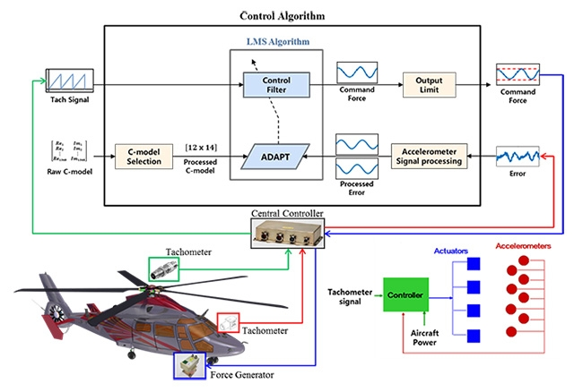
Korea Aerospace Industries Develops Helicopter Active Vibration Control System Software to DO-178C Standards
Challenge
Develop and verify active vibration control system software for helicopters
Solution
Use Model-Based Design to model, simulate, and verify the control software in accordance with DO-178C
Results
Development time halved
Design iterations minimized
DO-178C development simplified
The KAI active vibration control system.
“For our team, it is easier to develop control software using Model-Based Design than to code directly in C. Model-Based Design eliminates the overhead and errors that are common when control engineers create an algorithm and specification to be implemented by software engineers—a vital consideration when the project must meet DO-178C or DAL-C standards.” - Dong-il Kwak, Korea Aerospace Industries
Link to user story
Notes:
Industries: Aerospace and defense
Application Areas: Embedded systems, Control systems
Capabilities: Data analysis, System design and simulation, Embedded code generation, Verification, validation, and test
Products Used: MATLAB, Simulink, Embedded Coder, Simulink Verification and Validation, Stateflow
Country: Korea
Korea Aerospace Industries Develops Helicopter Active Vibration Control System Software to DO-178C Standards
When a helicopter is in flight, the rotor blades generate vibrations that travel down the aircraft’s vertical mast and into the fuselage. Left unchecked, these vibrations can shorten the operational life span of electromechanical and structural components and compromise onboard avionics systems. Passive vibration control systems absorb some of the vibration, but they cannot easily adjust to changes in rotor RPM or flight speed.
Development engineers at Korea Aerospace Industries (KAI) and Korea Aerospace Research Institute (KARI) have designed an active vibration control system (AVCS) that dynamically reduces vibrations generated by the main rotor over a range of operating conditions. A core technology of Korea’s LCH/LAH development program, the AVCS DAL-C software was developed in accordance with DO-178C using Model-Based Design with MATLAB® and Simulink®.
“We developed a dynamic model of the AVCS algorithms using Model-Based Design and following DO-178C and DO-331 standards,” says Dong-il Kwak, AVCS development program manager at KAI. “This approach enabled us to reduce design iterations, generate highly reliable C code, and then verify the code using software-in-the-loop and processor-in-the-loop testing.”
Challenge
Because the AVCS project represents just one component of the much larger LCH/LAH program directed by the South Korean government, the KAI team had to adhere to that program’s strict delivery schedule.
The team’s five control engineers had relatively little experience with programming embedded software, and this would be the team’s first DO-178C project.
KAI wanted to speed development by verifying algorithms as early as possible through modeling and simulation, and to minimize the errors that could be introduced by hand coding.
“For our team, it is easier to develop control software using Model-Based Design than to code directly in C. Model-Based Design eliminates the overhead and errors that are common when control engineers create an algorithm and specification to be implemented by software engineers—a vital consideration when the project must meet DO-178C or DAL-C standards.”
- Dong-il Kwak, Korea Aerospace Industries
Solution
KAI/KARI engineers developed and verified the AVCS software using Model-Based Design with MATLAB, Simulink, and Embedded Coder®.
The main inputs to the AVCS come from the aircraft’s onboard accelerometer and tachometer. Working in Simulink, the team developed models to process the real-time signals generated by these sensors.
The team created a Simulink model of the system’s main control algorithm, which generates commands to a circular force generator connected to the fuselage. The algorithm uses tachometer and accelerometer measurements together with a system identification model to calculate force commands that reduce vibration on the airframe.
The runtime system identification algorithm, which captures the system’s dynamic characteristics in flight as a transfer function between force and acceleration, was created with Simulink and Stateflow® using a set of force commands and measured response data.
The team used Simulink Check™ to check for compliance with KAI and DO-178C modeling standards and Simulink Requirements™ to establish traceability between model components and requirements managed in IBM® Rational® DOORS®. They used Simulink Coverage™ to measure model coverage as they simulated the design.
Using Embedded Coder, the engineers generated about 7000 lines of C code from their control model. To verify this code, the team ran software-in-the-loop (SIL) tests in Simulink using the same test cases that they had used in simulations. Next, they ran processor-in-the-loop (PIL) tests on an evaluation board equipped with the same processor as their target hardware, a TI F28335 DSP.
The engineering team has completed development and verification of the AVCS control algorithms, and they are integrating the generated code with other components of the production software in preparation for hardware and software configuration, flight tests, and testing for Korea Institute of Aviation Safety Technology certification.
Results
■ Development time halved. “Without Model-Based Design, it would have taken more than double the time to complete the project,” says Kwak. “Model-Based Design enabled us to cooperate as a team more efficiently and to reduce human error by generating code from our models.”
■ Design iterations minimized. “By creating models and running realistic simulations in Simulink, we reduced iterations and rapidly converged on the least complex design that satisfied our requirements,” Kwak says.”
■ DO-178C development simplified. “Simulink made it possible to automate several key development tasks on our first DO-178C development project, including running test cases, generating code, and identifying changes to be merged,” says Kwak. “We expect certification to go smoothly because with Model-Based Design, both our process and our design are easy to visualize.”
Learn more about Korea Aerospace Industries: www.koreaaero.com/english/

Slide 10
Opening Control Design Onramp
Available for 2020b or newer
From MATLAB open Simulink
In the lower left-hand section under “Learn” select “Control Design Onramp with Simulink”
Click “Course Overview” to get started

